Slide 1

Problems on Joint PDF 2002

Slide 2
Reference
Data
Youtube
Code

Slide 3

[2002]

Slide 4
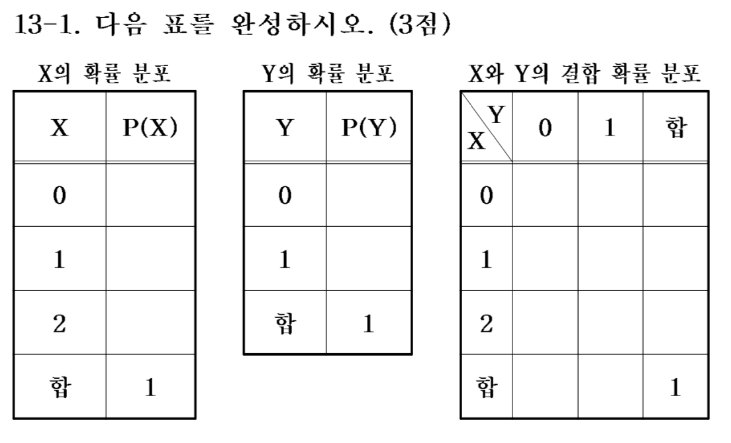
[2002]

Slide 5
[2002]

Slide 6


Slide 7
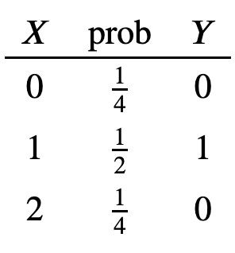

Slide 9
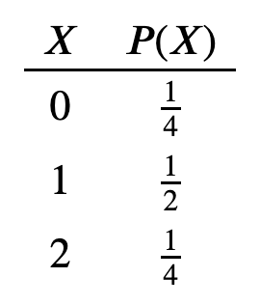

Slide 10
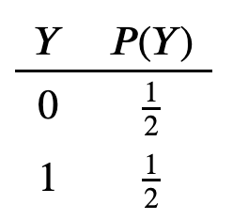

Slide 11
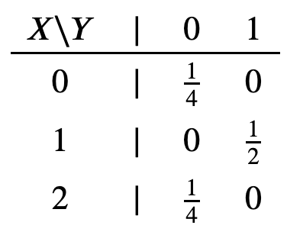

Slide 13


Slide 14


Slide 15


Slide 17
X, Y not independent

